Slide 1

AUTOMOTIVE ANALYTICS
Toyota Corolla Price Prediction
Multiple Linear Regression analysis of market depreciation, featuring iterative model optimization.

Slide 2


ITERATIVE MODELING PROCESS
Model 1: The Baseline
Model 2: The Refined Model
The initial multiple linear regression included all available variables. However, hypothesis testing (p-values) revealed that Doors and Gears were not statistically significant predictors of price.
To prevent overfitting and improve model simplicity, we dropped the insignificant features (Doors/Gears). Model 2 focuses strictly on the highest-impact mechanical and usage metrics.

Slide 3
MODEL PERFORMANCE COMPARISON
Feature Importance (Coefficients)
Gears | 563.91 | 563.91
HP | 38.59 | 38.59
Weight | 19.70 | 19.70
Quaterly_tax | 8.20 | 8.20
KM | -0.019 | -0.019
CC | -2.17 | -2.17
Doors | -15.89 | -15.89
Age | -120.44 | -120.44
Metric | Description | Model 1 (All Features) | Model 2 (Refined)
R-Squared (R²) | % of price variance explained by the model | 0.8595 | 0.8595
RMSE | Root Mean Squared Error (Average prediction error in €) | 1239.03 | 1239.03
Insight: By dropping 'Doors' and 'Gears', Model 2 maintains a similar R² score

Slide 4
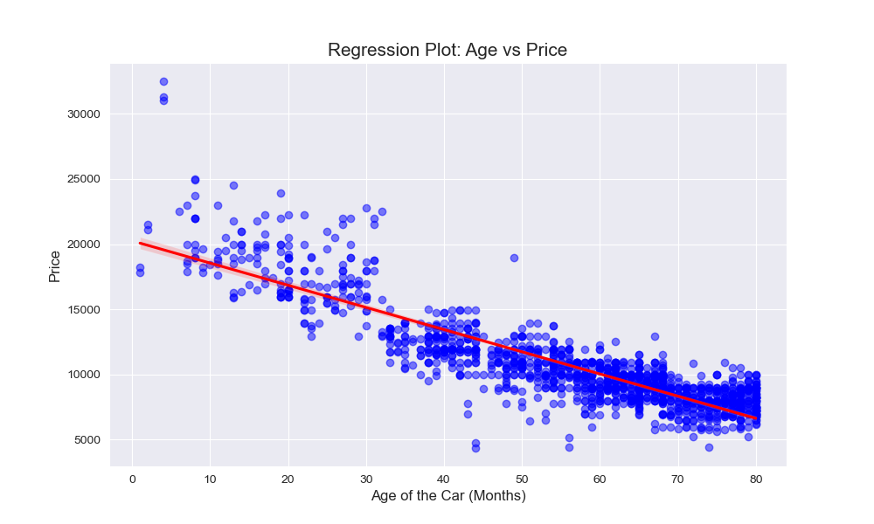

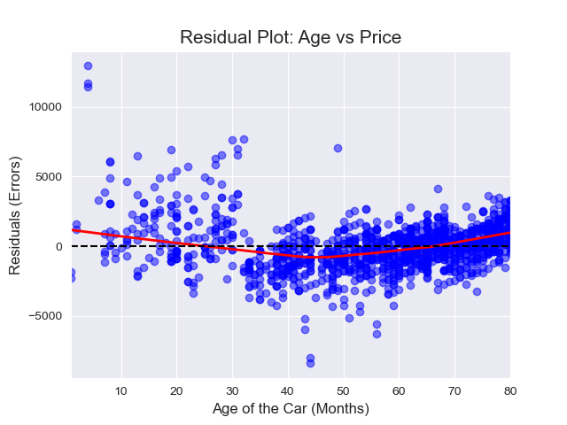
DIAGNOSTICS: MODEL 2 VALIDATION
Regression & Residuals
The Regression Plot confirms our line of best fit captures the core market trend.
The Residual Plot verifies Homoscedasticity. Because the errors are randomly distributed without clear patterns, we confirm that linear regression is the correct algorithmic choice for this dataset.

Slide 5
Strategic Conclusion
Model 2 successfully isolates the true drivers of depreciation. By utilizing this refined model, dealerships can predict Toyota Corolla trade-in values with high precision, avoiding the noise introduced by irrelevant features like doors and gears.

